Slide 1
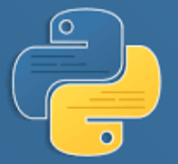
Python

Slide 2



List
List is a collection of sequential data that are ordered and mutable and all of the data may have different type with each other.
We use list by putting all data in a square bracket “[]” .
Declaring a List:
Here are some of the ways we can declare a List.
Accessing a List:
To access a list, we just have to identify the index of the data that we want or we can also use range to fetch multiple data.

Slide 3
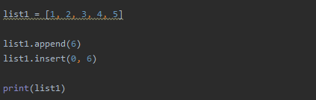



List
Adding an element:
To add an element we can use the method append and another is insert if we need to specify the index.
Updating an element:
To update an element, we just need to assign the value to an existing index in the list.

Slide 4
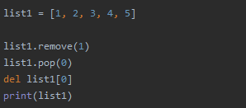

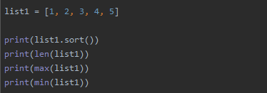

List
Deleting an element:
To delete an element, we can use remove if we want to remove the value itself, del and pop to remove using an index.
Python provides built-in function for list, here are some of the functions available.

Slide 5



Tuple
Tuple is almost the same with the List, Tuple is a collection of sequential data that are ordered and immutable.
We use tuple by putting all data in a round bracket “()” .
Declaring a Tuple :
Here are some of the ways we can declare a Tuple.
Accessing a Tuple :
To access a Tuple, we still have to use square bracket and identify the index of the data that we want or we can also use range to fetch multiple data.

Slide 6
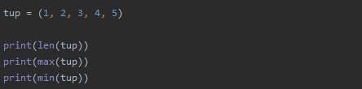

Tuple
Since Tuple is immutable; adding, updating and deleting an element is not allowed.
Python provides built-in function for Tuple the same with the List except for those that can mutate a Tuple, here are some of the functions available.

Slide 7



Set
Set is a collection of sequential data that are unordered and mutable.
Another difference of Set is that it does not allow repeating elements.
We use Set by putting all data in a curly bracket “{}” .
Declaring a Set :
Here are some of the ways we can declare a Set.
Since Set is an unordered object, its element doesn’t have index therefor we cannot access the elements individually.
Adding an element:
To add an element in a Set, we can use the method add.

Slide 8


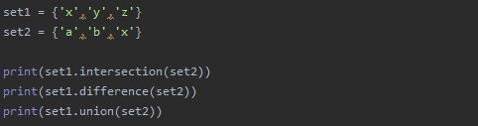

Set
Deleting an element:
To delete an element in a Set, we can use the method remove.
Python provides built-in function for Set, here are some of the functions available.

Slide 9





Dictionary
Dictionary is a key value pair. Dictionary is mutable by whole but key is an immutable and unique object while value is the opposite, value my not be unique and is mutable.
We use Dictionary by putting all data in a round bracket “{}” .
Declaring a Dictionary :
Here are some of the ways we can declare a Dictionary.
Accessing a Dictionary :
To access a the value of a Dictionary, we just need to call the value using the its key pair.
We can also use a built-it function .get to get a value and we can assign default text if it doesn’t exit.

Slide 10





Dictionary
Adding a key value pair:
Adding a key value pair in a dictionary is easy, we just need to add a unique key plus its value to the dictionary.
Updating a Dictionary :
Since value is mutable, we can update it by simple assigning our desired value to its key pair.
We can also update multiple values at a time in a dictionary.

Slide 11




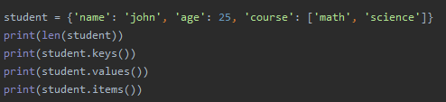

Dictionary
Deleting a key value pair:
To delete a value in a dictionary, we can use the method del.
To delete all entries, we can use the clear method.
Python provides built-in function for Dictionary, here are some of the functions available.

Slide 12








User Input
In Python accepting user input is easy, we just have to use the method input.
We can also add some text so that the client will know that the program is expecting a user input.
By default the input method will give us a string so if we want to use it as a number, we need to convert it to either integer or float.
There is also the concept of eval method where it accepts an expression and evaluate it and give us the answer.

Slide 13


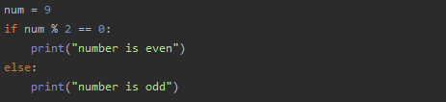

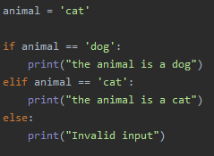

IF Statement
We use IF statements if we are coding conditional expressions. It will execute the code when the condition is True.
For a code to belong to the if statement, it only needs to be indented, unlike other programming language where they use curly braces {}, in python it is not needed.
Unlike other programming language, IF statement doesn't need any ending block that suggest the end of the IF statement.
For us to also have an output when the condition is false, we can use else.
We can also have multiple condition by using elif.

Slide 14
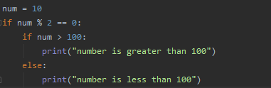

IF Statement
We can also do a nested IF statement, it is when we put IF statement inside another IF statement.
As you can see we can have an entire tree of IF statements together
Python also has the concept of a 1 line IF statement where it only gives us 2 outputs, true or false.

Slide 15


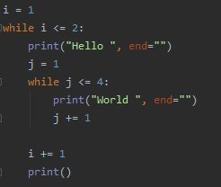

While Loop
In general, we use loop codes if we are in a situation when we need to execute a code multiple times.
In While loop, we usually have an initialization, condition, codes, and increment/decrement.
Python also supports nested While loops, where we have while loops within a while loop.
Its important to not forget the increment/decrement because our codes my go to infinite loop if we don’t include it to our codes.
In the print method, by default it will create a new line. To negate the new line we just need to use the end keyword

Slide 16










For Loop
In this lesson we will talk about For loops. For loop and While loop are both loops but we usually use them differently. Normally we use While loops for certain iterations and conditions while For loop, we normally use them for sequence. These are list, tuple, set, dictionary and string.
Basically one by one it will fetch the value.

Slide 17




For Loop
While looping in dictionary and list, what if we wanted to get the key value pair in the dictionary and the index value pair in the list? We can do this using a method items for dictionary and enumerate for list.

Slide 18
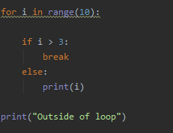
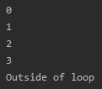
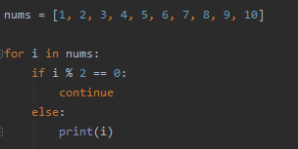

Break, Continue, Pass
We have discuss about if statements and For loops, now we will discuss the keywords Break, Continue, and Pass and how it is use within our block of codes.
Break is normally being use inside loops, its main purpose is to stop the loop but not the entire execution, it will just come out from the loop.
Continue is also use inside loops and its main difference with the break is, it skips the remainder of its body and just let the loop continue.

Slide 19
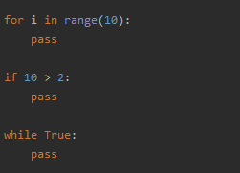
Break, Continue, Pass
Pass is use when we have a certain statements but don’t contain any code to be executed.
Unlike break and continue, Pass can be use in any statements that we have.

Slide 20
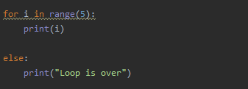
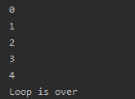
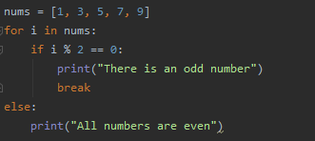

For Else
For Else is unique in Python, we can use For loop and else statement together.
The Else keyword will be executed after the loop is finished.
We can also use it with the break or continue keywords.

